Slide 1
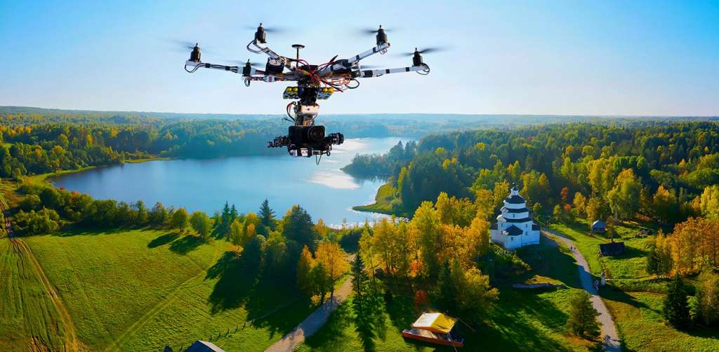
AIRWAY DELIVERY
Marketing department
BY : shubham kumar

Slide 2
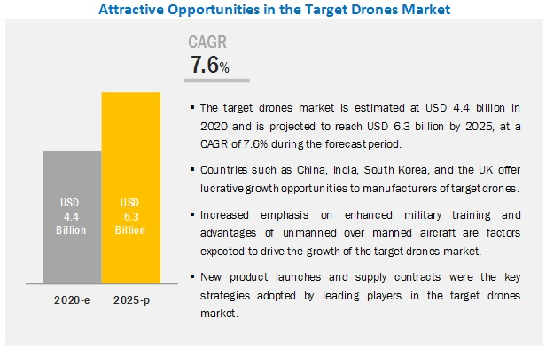
The target market for drones delivery
The target market for drones is very diverse. Drones can be used for many different things ranging from military applications to hobbyist. The drone market is expected to be worth over $91 Billion within the next decade. Military spending still dominates the market, but consumer markets are growing quickly. Geographically, drones can be used worldwide. The drone market is global which allows for many marketing possibilities (Drones: A Rising Market, 2015). Demographically most drones are bought by men. Most consumers including the military are Caucasian or Asian. The market spans across all age groups and are generally high income and/or college educated. The psychographic segment of the target market is very diverse. For thedefense side of the market psychographic analysis includes safety and security minded. Cost, technology, data security is also very important to the defense sector of the drone business. The consumer side is interested in new technology for photography, and hobbyist applications. Cost is more important to this segment of the market. The consumer is also looking for the drones to be more user friendly since most are not trained as in the military.

Slide 3
STRATEGY AND POSITIONING ANALYSIS
The market needs for drones is increasing dramatically not only for the military applications, but also for commercial applications. The military will only increase their drone arsenal over the next few years. Drones provides a way to keep humans out of potentially dangerous situations Drones can be used for surveillance, but also can launch a missile attack without a soldier being in the area. Drones can also be used to drop of supplies in remote areas orto troops in a battlefield. The military need for drones will only grow as the technology grows, potentially making a majority of aerial surveillance and weapons remote controlled The needs in the consumer market can range from entertainment for a hobbyist, or to be used as business tool. Real estate agents are using drones for aerial photos of the homes or businesses they are selling. Large companies such as Amazon are looking into drones to delivery merchandise instead of using traditional delivery methods. Drones are also being utilized by many organizations for photography and filming. This can be as simple as a hobbyist filming their child’s soccer game ora major television networking covering an NFL game realtor (Drones: A Rising Market, 2015).

Slide 4
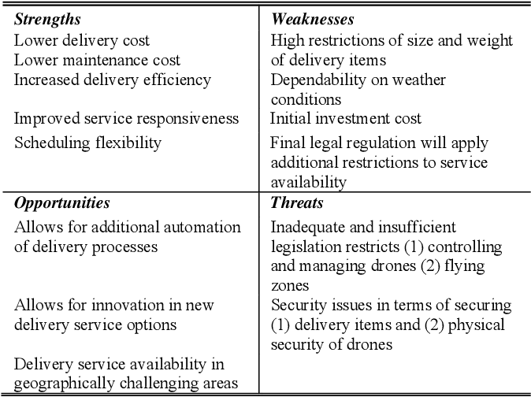
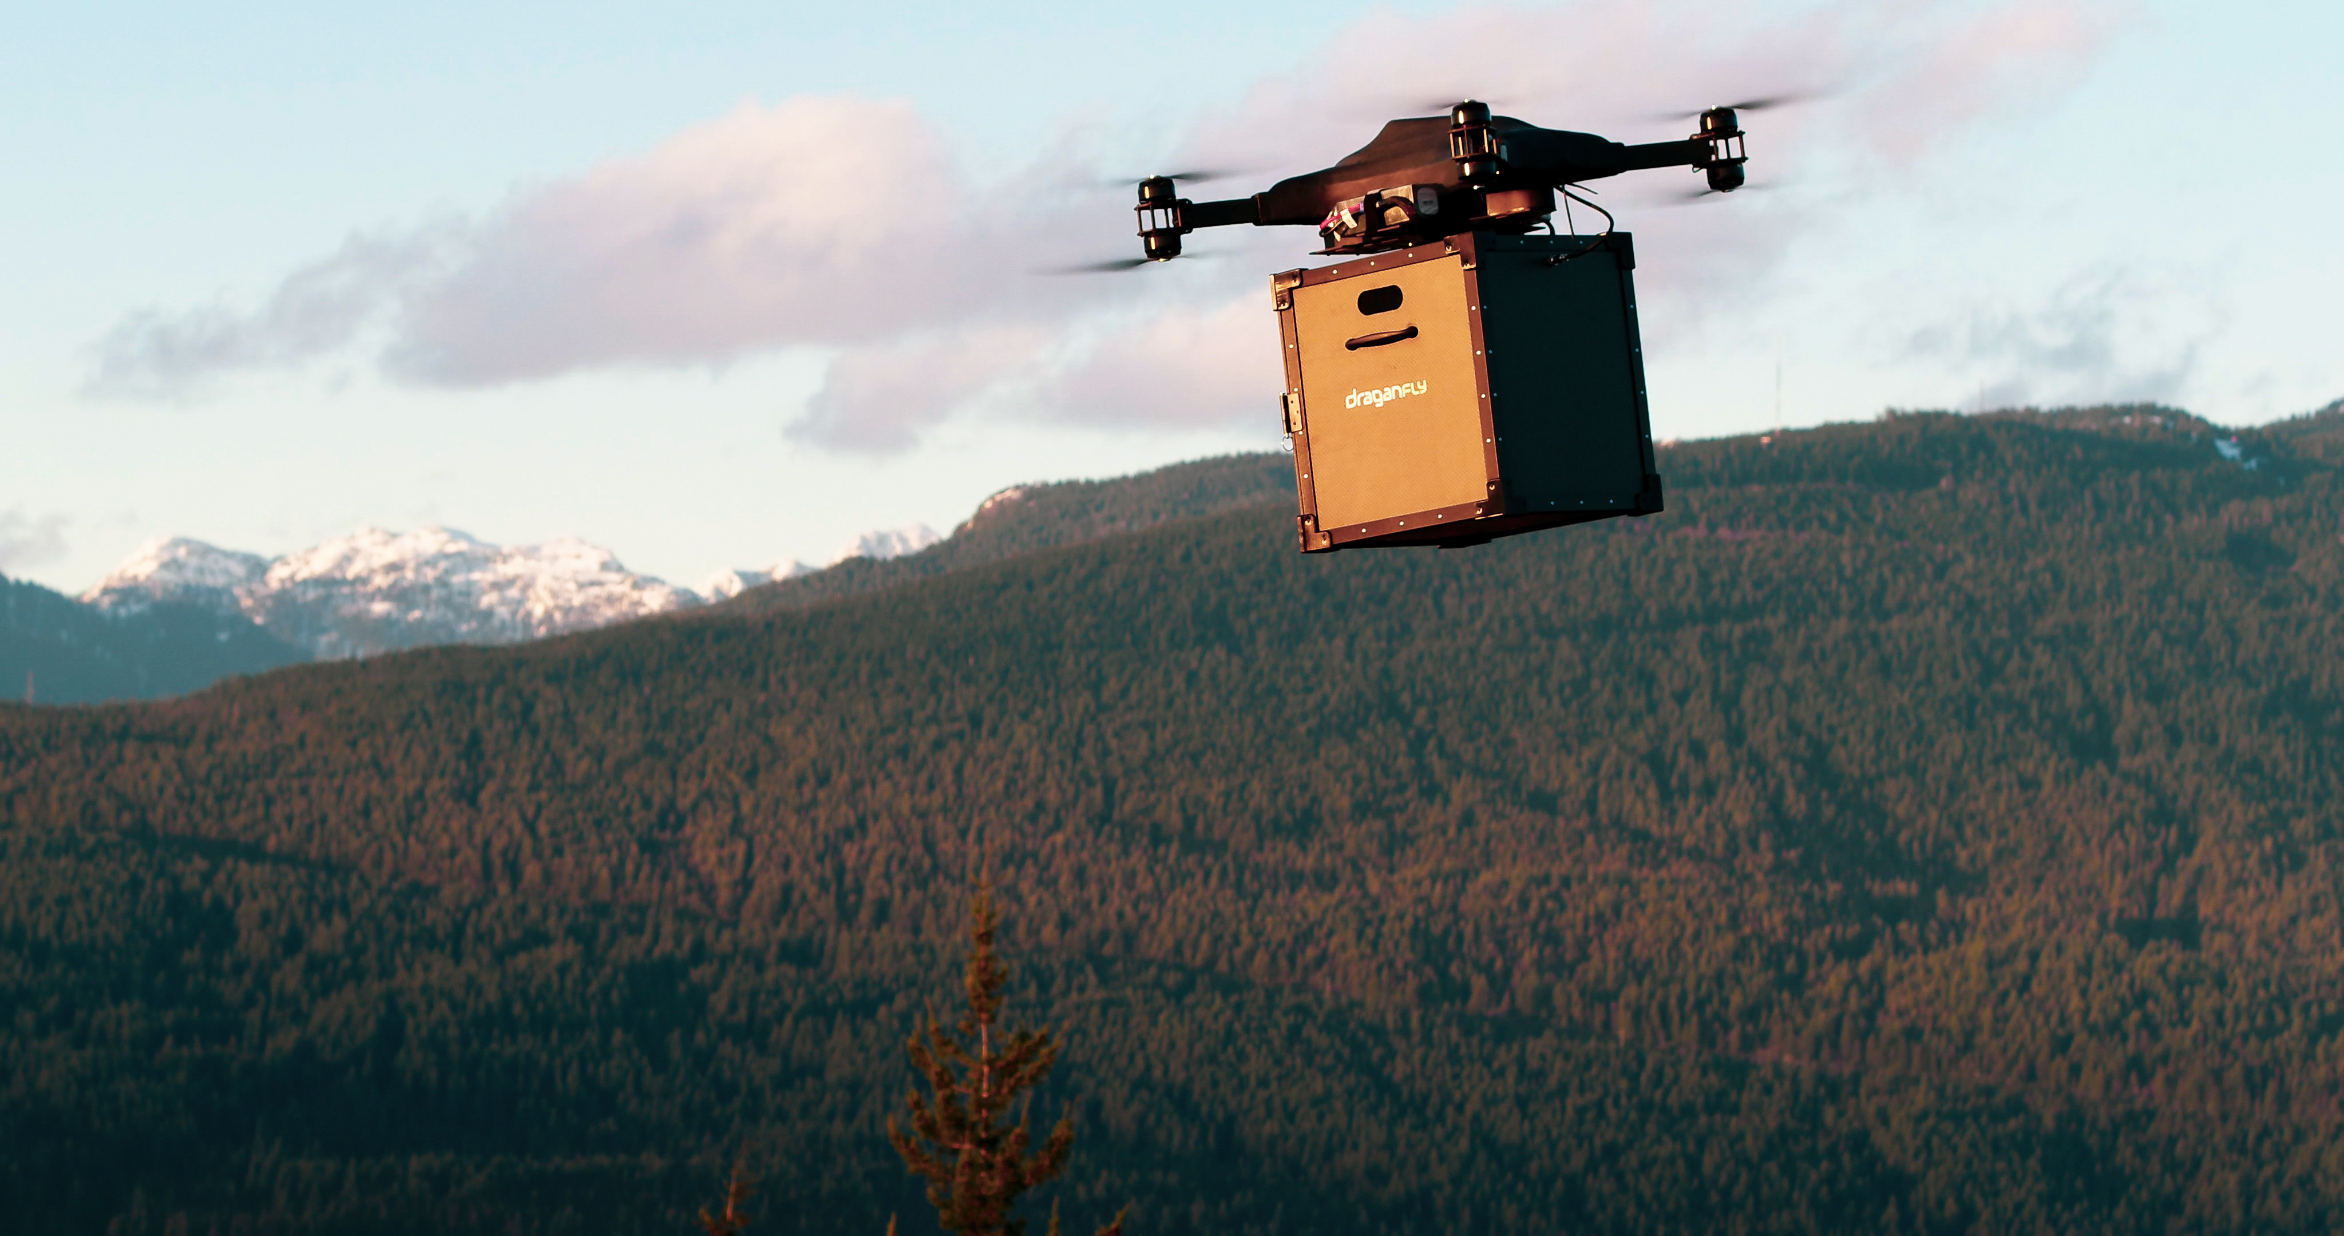
SWOT ANALYSIS

Slide 5
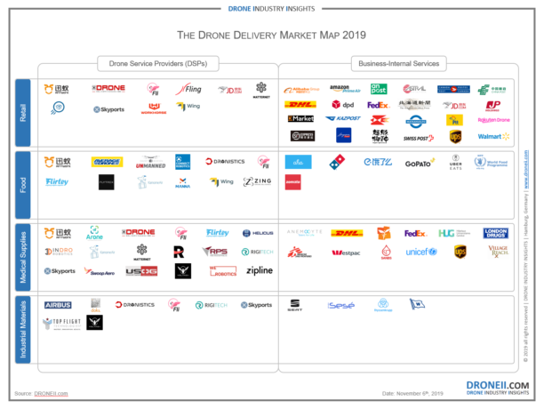
MARKET MAP

